Slide 1
Lifecycle and methodologies in OSS - Unique Characteristics of the OSS Development Process Model
Dr. Ritu Arora
Assistant Professor (Off-Campus)
Department of Computer Science & Information Systems
BITS, Pilani

Slide 2
Unique Characteristics of OSS Development Model
Release early, release often: The code is made public and a development version of the software is released as soon as the same is available
Does not wait for a fully working version
Advantages:
Allows for peer review
Early suggestions and comments
Early Bug fixes
Results in generation of high quality code
Small incremental changes – that are easy to understand, test and correct

Slide 3
Unique Characteristics of OSS Development Model
Peer Review: Exhaustive review of code by community – more eyes looking at it
Faster comment and feedback
Early identification of bugs
Improved quality
Small, Incremental changes: For a larger period of the development cycle, the changes are in the form of small code patches which are easy to understand, test and resolve
Beneficial since they help in focusing more on testing phase, which is cyclic and is continuously executed with every increment of the software
Small changes are less likely to introduce cascading or unintended consequences.

Slide 4
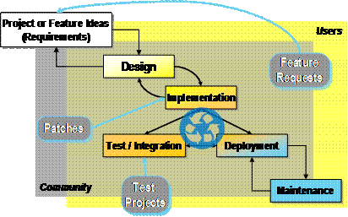
Open Source Software Development Model
(Source: Haddad, Ibrahim, and Brian Warner. "Understanding the open source development model." Linux Journal (2011))

Slide 5
Unique Characteristics of OSS Development Model
Highly secure code: OS community considers security as a very important aspect and any code that raises security concerns is flagged and not included in the project.
Continuous quality improvement: Exhaustive peer review and early identification and fixing of bugs leads to improved code quality.
Test projects: Large open source projects also create separate test projects consisting of all large numbers of test suites and make use of automated testing tools.
End user involvement: The end user are continuously involved in all phases of the development model.

Slide 6
Recommended Practices
Corporates can benefit from adopting certain practices that are followed in the OS development model:
Increased team communication
End-user feedback
Peer review
Release early and often
Transparency
Good code designs

Slide 7
Thank You!
In our next session:
Lifecycle and methodologies in Open Source Software –
Comparing OSS development methodologies with traditional methodologies

